Slide 1
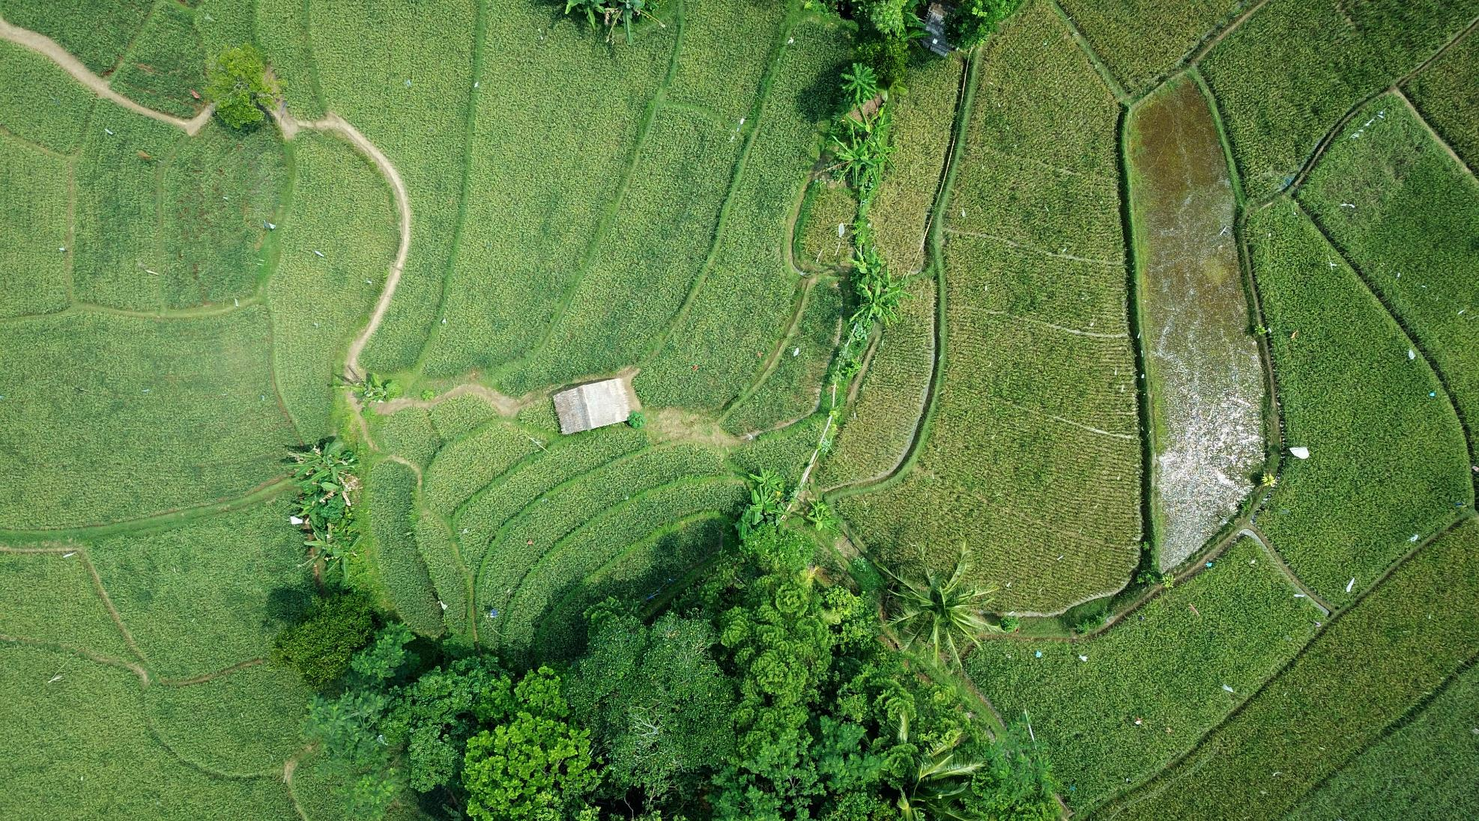
Gardening and Lifestyle
How can Data Science help the web market?

Slide 2

About Us
Anjela Melkonyan - Software
Ivan Germanov - Software
Stijn Groenen - Software
Bart Verhagen - Business
Ries van Geffen - Software
Redzhep Molaahmed - Software
ADS-A 34 / Group B

Slide 3


The Problem
Utilize data
Data Ethics
Capture the benefits of using Big Data
Comply with regulations

Slide 4




Solution and Results
Exploratory Data Analysis and Recommendations
Customer Churn Prediction Model
Forecasting
Demand Model
Analyze the Data and capture beneficial information
Define and Analyze customer churn and capture valuable factors
Forecast market demand and predict sales
Notes:
We performed exploratory data analysis and captured beneficial information which we’ll go over together with our recommendations.
We then built a customer churn prediction machine learning model by defining when a customer is considered to have churned (when he leaves our business).
Finally we built a prediction model for forecasting the demand of different categories.
My colleagues Redzhep and Bart are going to talk about the EDA and recommendations, Anjela and I will talk more about customer churn and Ries and Stijn will go over the demand model and data ethics.

Slide 5

Exploratory Data Analysis Bart and Redzhep
Gender distribution
Age distribution
Revenue per category
Distribution of orders per customer
Delivery time
Returns
Churn

Slide 6
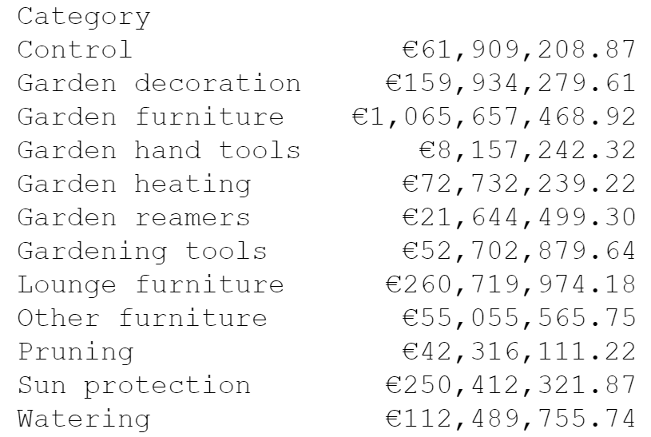
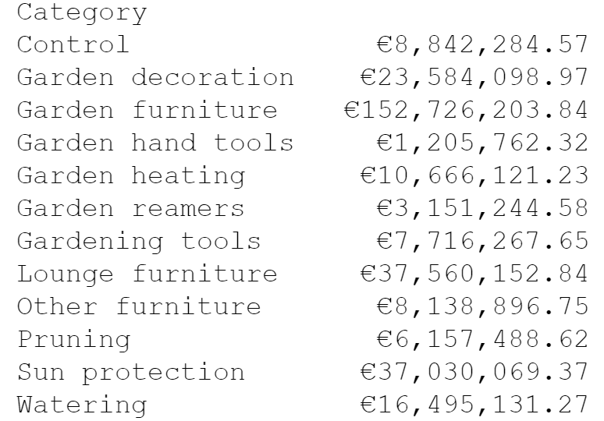
Revenue
From 2013 to 2017
2018
Notes:
We can see the sum of revenue between 2013 and 2017. We took the average from this and divided 2018 by the average. Here we discovered that we have 30% less revenue comparing to the average of 2013 to 2017.

Slide 7
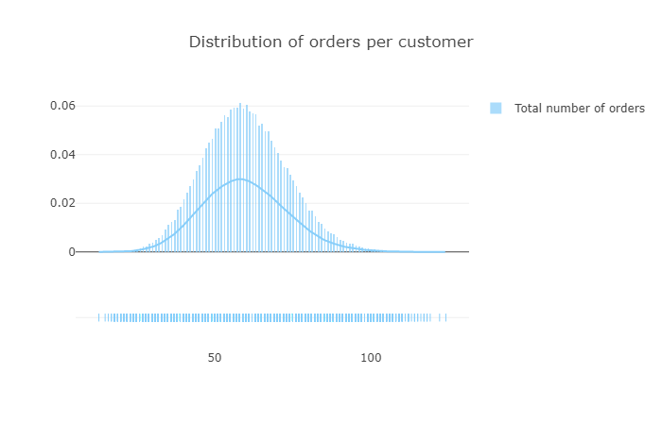
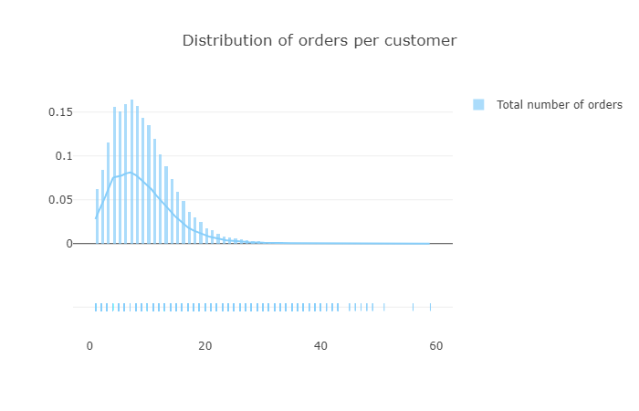
Distribution of orders per customer
From 2013 to 2017
2018
Notes:
Y-axis is the distribution
X-axis is the orders per customer
We have less orders per customer but more value has become higher. So we recommend to lower the prices to gain more customers.

Slide 8
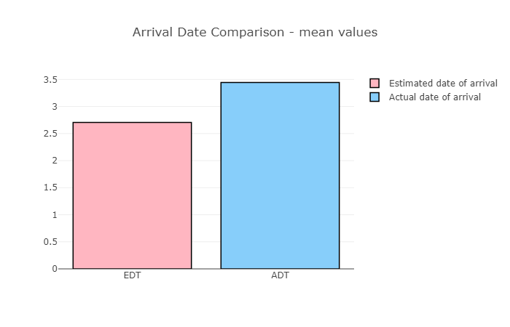
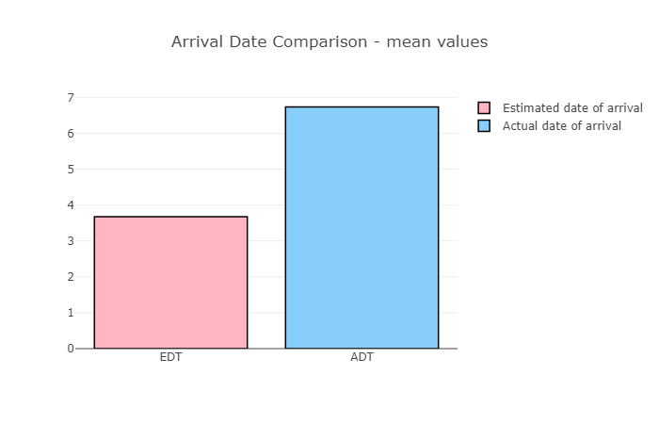
Logistics and delivery
From 2013 to 2017
2018
Notes:
Y-axis average deliverytime in days. In these graphs we can see that there is an increase of 200% delivery time in 2018 compared to the data from 2013 to 2017. So we conclude that there are logistics problems, we suggest to try find out which department is causing this problem.

Slide 9
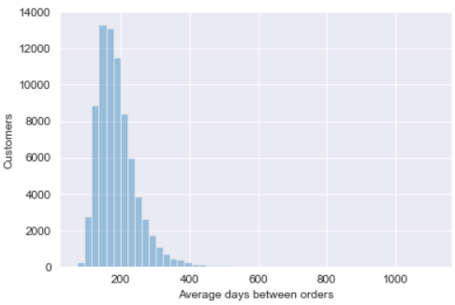
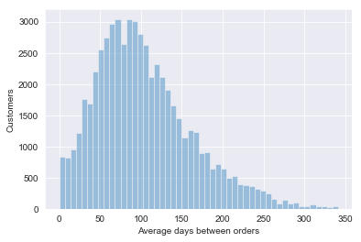
Average days between orders
From 2013 to 2017
2018
Notes:
We can see in the chart the average time-span between the orders for every customer.
The time period between 2013 and 2017 the time-span for a new order is 100 and 400 days, most of the time between orders being around 150-250.
In 2018 the time-span between orders has decreased to around 50-150.
That means that customers in 2018 have ordered more frequently throughout the year.

Slide 10

Customer Churn Ivan and Anjela
Why customer churn is important
Feature Engineering
How customer churn is defined and why
Model performance

Slide 11




Why customer churn is important?
Cost
5x more expensive to attract a new customer than to keep one
70% of companies agree
Increase profits
Increasing customer retention rates by just 5% increases profits by 25% to 95%
Probability of selling
The probability of selling to a prospective customer are 5-20%, for an existing one it’s 60-70%
Notes:
More benefits have been documented in the business case.

Slide 12





Feature engineering used in the model
Per customer
Average days between orders
Number of orders
Average rating – does not consider orders where no ratings were given
Percentage returned items
Estimated time of arrival/Actual time of arrival – proportion, takes value of 0-1

Slide 13


How customer churn is defined and why
Bob
Day 1
Day 15
Day 40
Day 80
Day 90
15d.
25d.
40d.
10d.
Mean
mean(15,25,40,10) = 22
STD
std(15,25,40,10) = 13
Mean
+
STD
22 + 13 = 35
The definition of when a customer
has churned can change to a longer or shorter time!
>35
We lost Bob!
How many days ago was the
last time Bob made an order?
<=35
Bob is still with us!
Notes:
Customer churn is going to be defined based on the number of days that a person has gone without making an order from us.

Slide 14

Churn Analysis

Slide 15
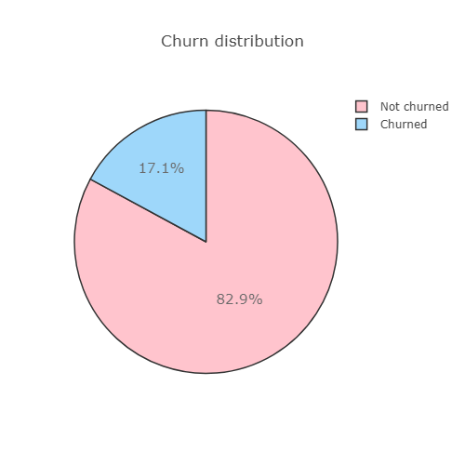
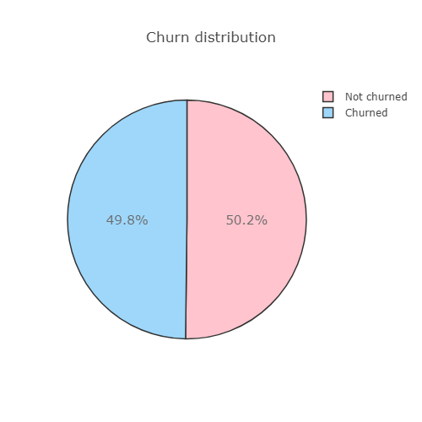
Churn distribution
From 2013 to 2017
2018

Slide 16
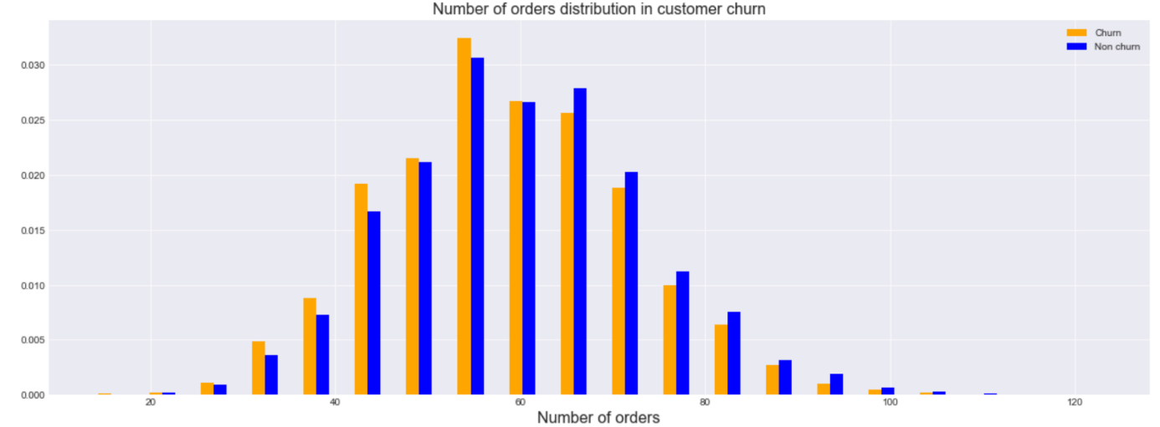
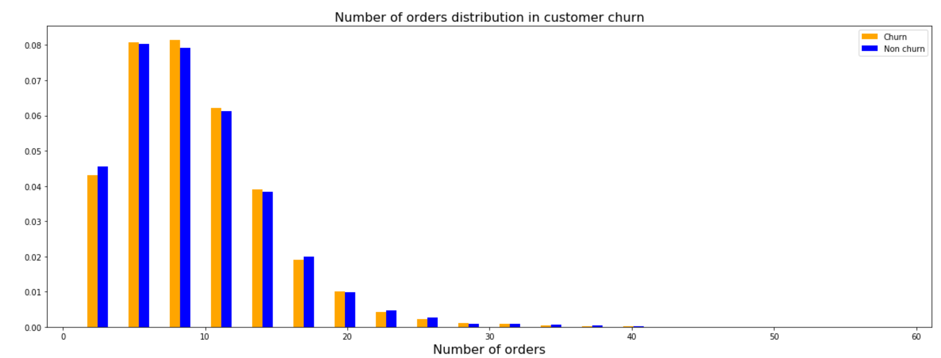
Correlation – number of orders in churn

Slide 17
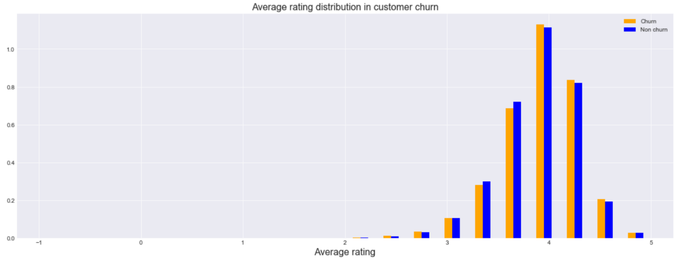
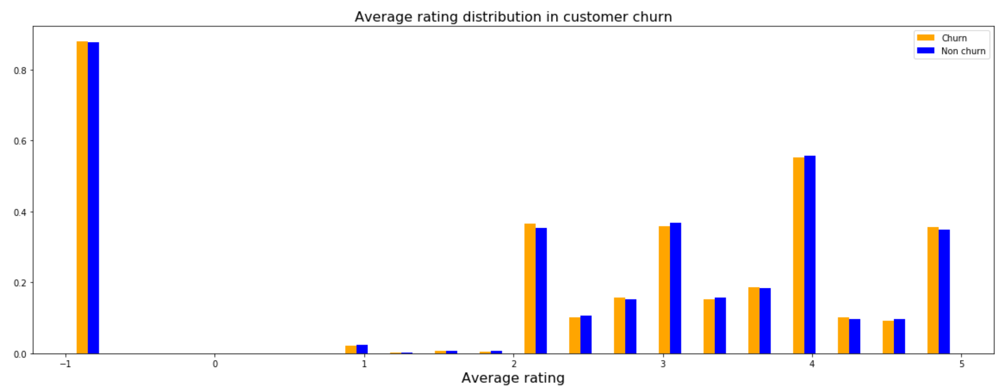
Correlation – number of orders in churn

Slide 18
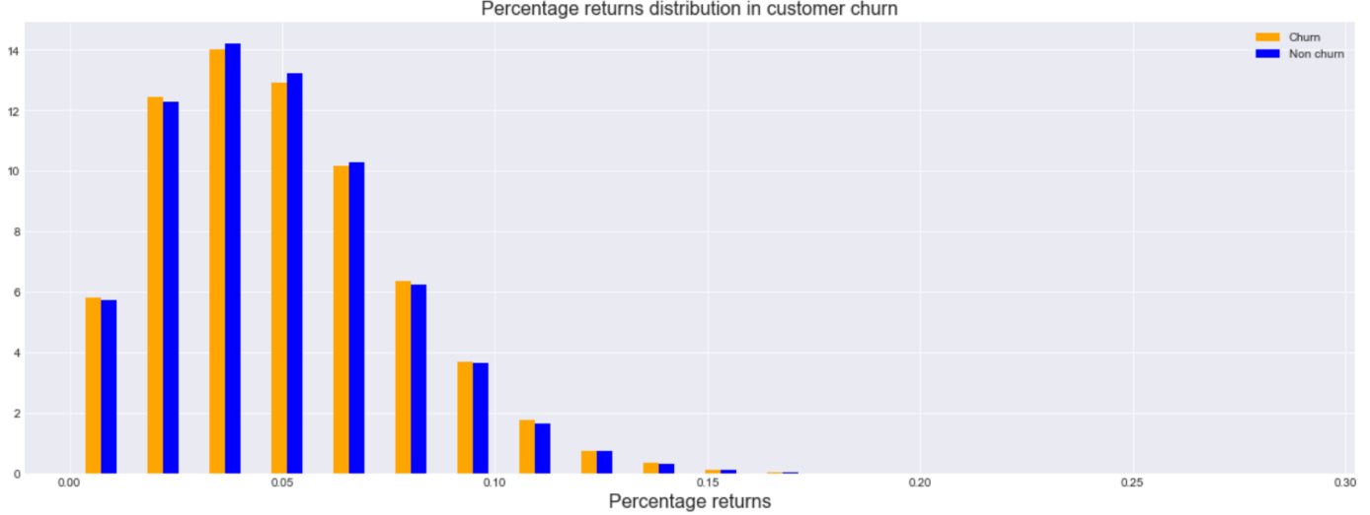
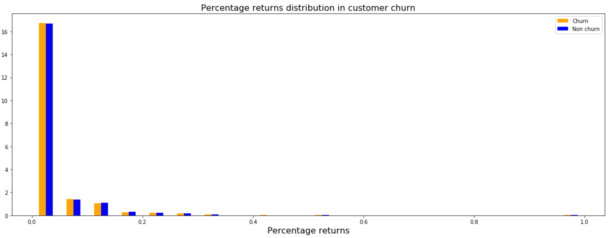
Correlation – number of orders in churn

Slide 19
The Models

Slide 20
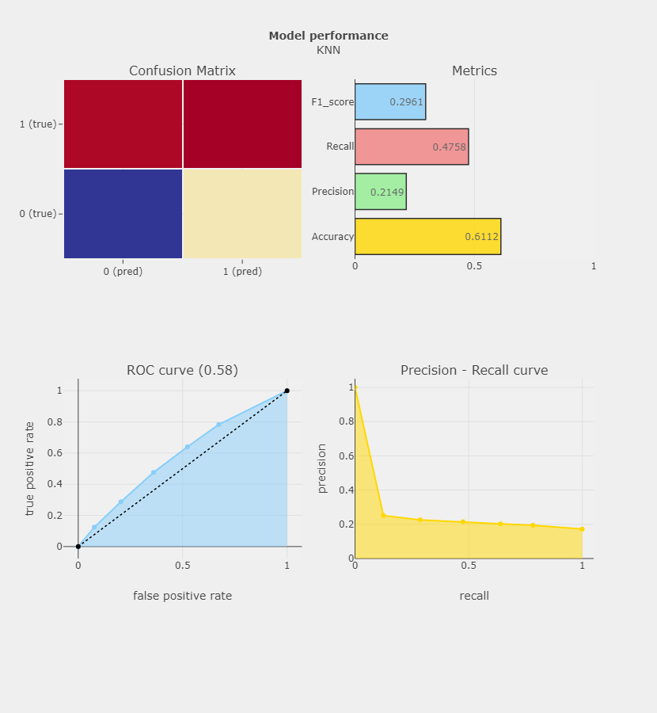
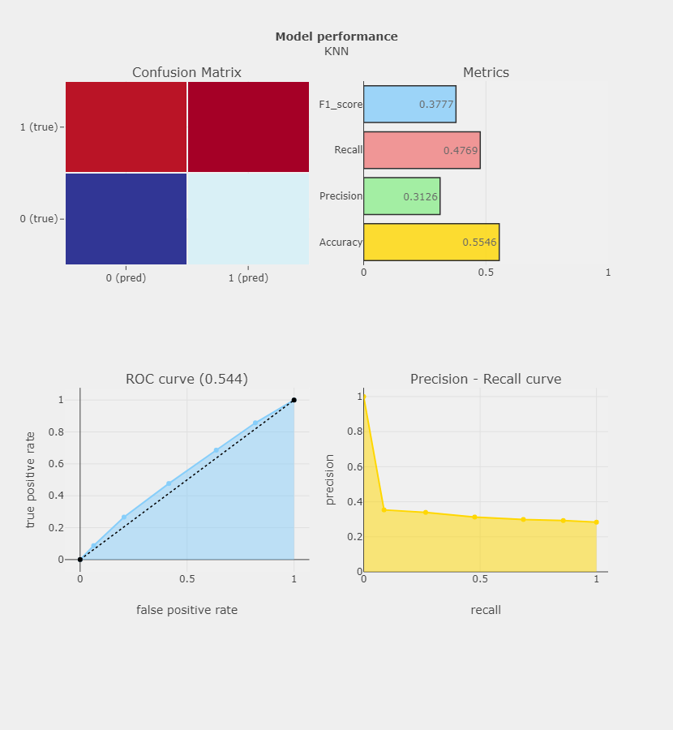
Data from 2013 to 2017
Data from 2013 to 2018

Slide 21
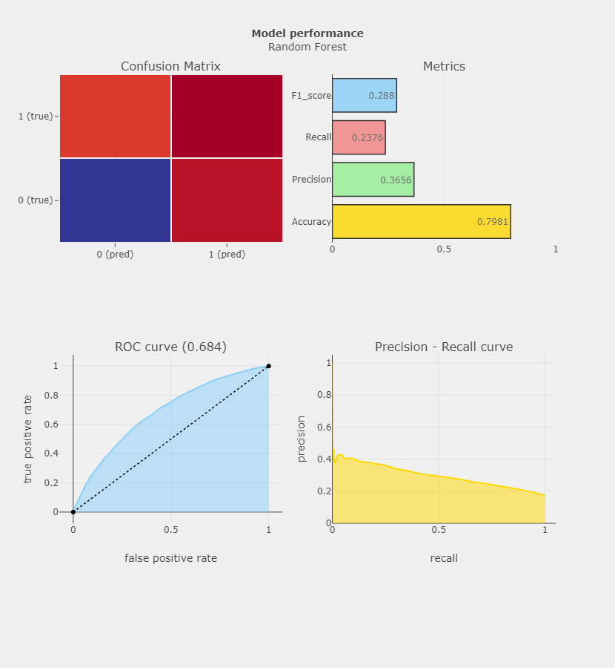
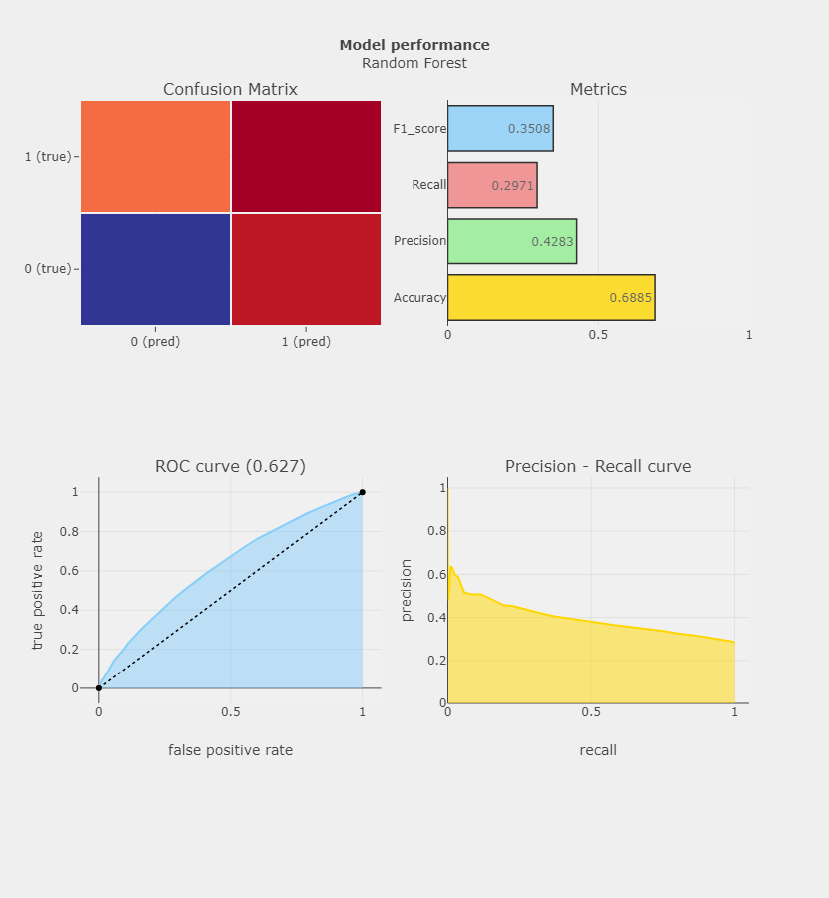
Data from 2013 to 2017
Data from 2013 to 2018

Slide 22
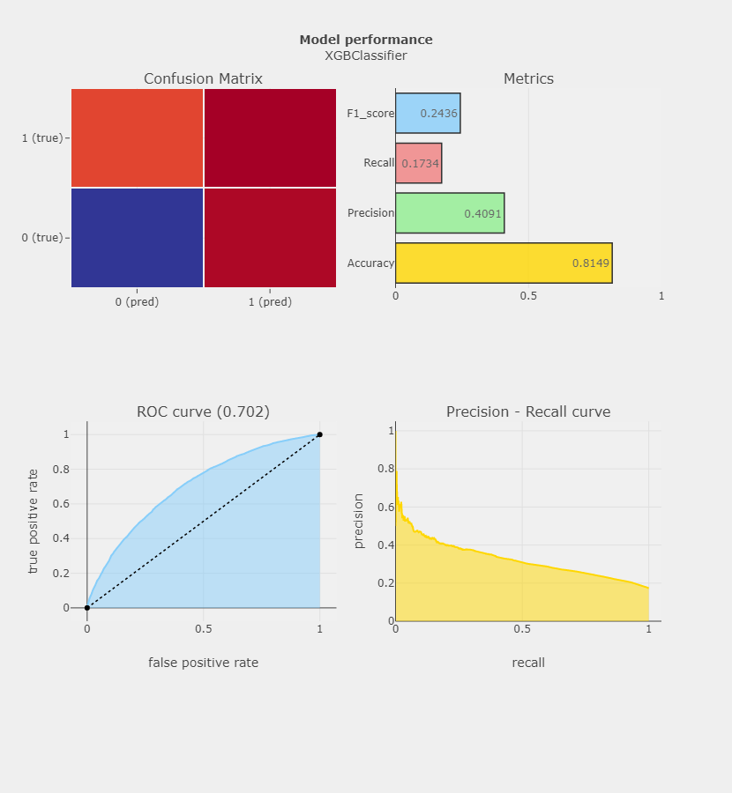
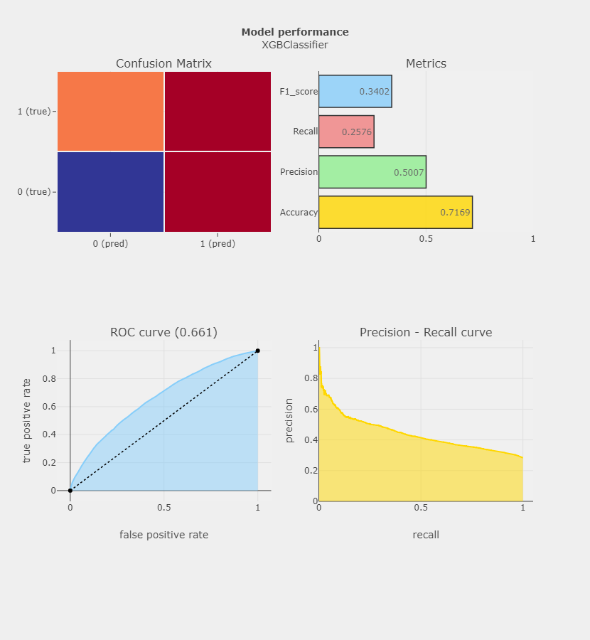
Data from 2013 to 2017
Data from 2013 to 2018
Notes:
implementation of gradient boosted decision trees designed for speed and performance that is dominative competitive machine learning

Slide 23

Forecasting Demand Model
Why is forecasting demand useful?
Why did we pick this model?
Within what scope did we forecast?
Notes:
Why is forecasting demand useful?
Forecasting can be useful for insight in what people will mostly be ordering in the future.
Why did we pick this model?
We used the ARIMA algorithm because according to our consultant this was the most fitted model/algorithm.
And after that we started researching and playing with it.
Within what scope did we forecast?
Our model forecasts by day.
At first when we started forecasting we tried forecasting the sales in general, so not a specific category.
Later we started forecasting just one category at a time but the results graph looked really similair.
We think that the reason for this is because all the sales are evenly spread over the different categories.
So we tried the model on all the categories combined and also on a few specific categories.
This model can now be used for any category to see how it would do during any season or month.

Slide 24
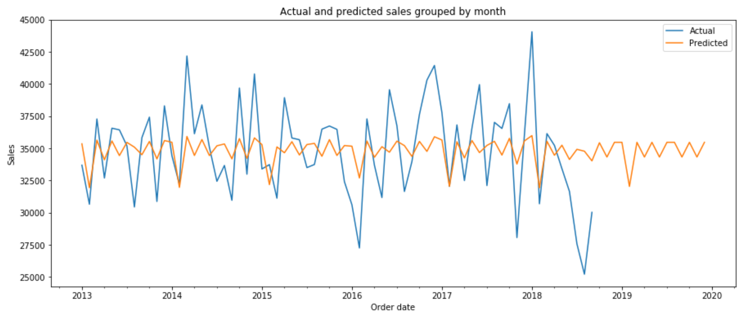
Results
Garden Furniture
Notes:
The graph is showing the sales made in the garden furniture category.
The blue line represents the actual sales based on our data.
The orange line represents the predictions from our ARIMA model.
We combined the datasets into one sales dataset. We took all sales in the garden furniture category and then we created a new dataset with sales per day.
This is the dataset we used to train our ARIMA model.
We added all sales together for each month to create this graph. We did the same for the predicted sales and added the results to the graph.
As you can see the ARIMA model came up with a pattern based on the actual sales in the past.
The troughs in our predicted pattern are close to troughs in the actual sales data.
Unfortunately the rest of our predicted pattern seems quite random. We think that the problem is that the actual sales data has no clear patterns in it for our model to train on.

Slide 25

Data Ethics
Ownership
Transaction Transparency
Consent
Privacy

Slide 26



Ownership and Transaction Transparency
Why is my data being collected?
Improving logistics
Improving demand and supply,
In general, improving business processes
How is my data going to be used?
Prediction models
Descriptive Analytics
How it can be amended by the individual concerned?
Ability of customer to delete their data
Notes:
Ownership
Individuals own their data. Personal data refers to data sets describing a person ranging from physical attributes to their preferences and behaviour. In this project, personal data taken into consideration includes: date of birth, place of residence, gender, products ordered, date of orders, written reason of return.

Slide 27


Consent
Privacy
User’s data is utilized only after the customer gives consent to their data being used.
Data obtained from a person should not be shared and exposed to any other businesses or individuals with any trace to person’s identity

Slide 28
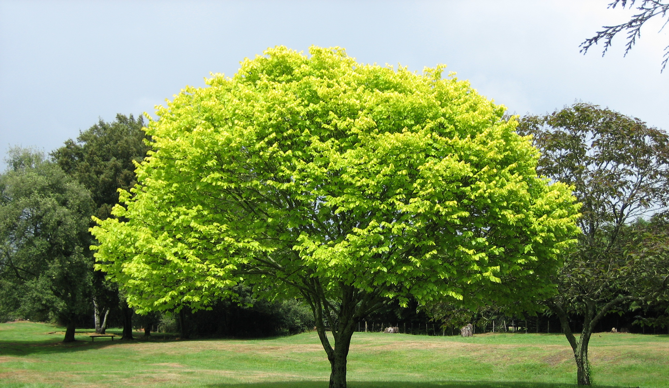
Conclusions
In general…
Feedback
Discounts
More Data (relevant analysis)
Forecasting demand…
Notes:
Forecasting demand
Using the ARIMA model to forecast demand could be very useful. Unfortunately, our results show that there is no clear pattern in the sales data for the model to train on, so the results don't tell a lot about the future.
Churn
Customers want to feel valuable.
badge-category -> you shop from a category x many times and you get a badge which result in discount
if a customer has been loyal for more than an year/half an year - you give them a discount
if an order is above certain amount - you add an extra product for free related to the order
personalized offer after given feedback
demographical analysis
send a discount when a customer has a birthday
every month have a 20h flash sale (for clients having more that 5-6 orders for 8-9 months)
More Data : new data sources can be used on top of the usual transactional CRM data (profile and purchase history) to improve the performance of the predictive models - service usage, client feedback and customer service requests, social media interactions, web tracking data...can all be revelatory of customer churn.

Slide 29
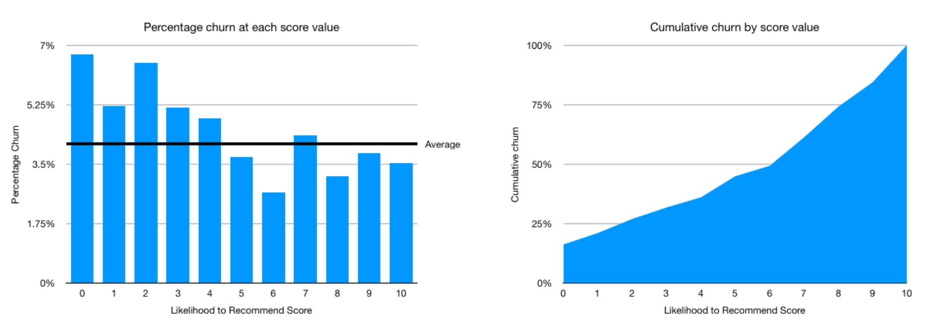
Why is Feedback valuable?

Slide 30
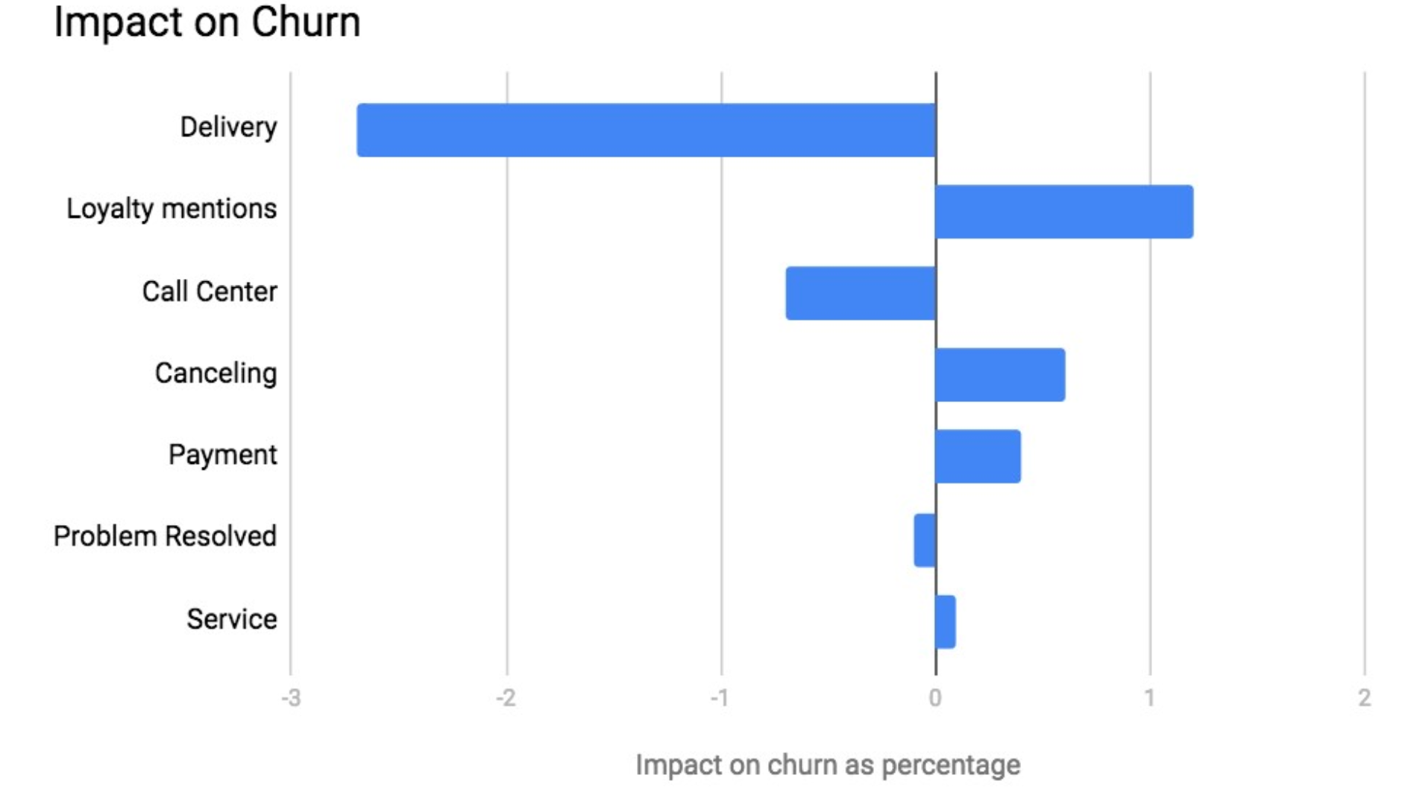
For example
Source: Thematic

Slide 31


Thank You
ADS-34 Group B

